Slide 1
Enhancements in Java 7 & 8
Stuff you should already be using 😁

Slide 2
Intro
Recent Java release history

Slide 3
Intro
”Java” means “Java SE” – the language, JDK, and runtime
Java 7: July 7, 2011
Java 8: March 18, 2014
CyberScout only transitioned to Java 8 in 2016
The Subscription application is the notable exception, as it’s still on Java 6

Slide 4
Intro
Starting after the release of Java 9 on September 21, 2017, Oracle went to a new release cadence
Major releases (new features, potential breaking changes) every 6 months
Update releases (patches) every quarter
Long-term support releases every 3 years
Support for one major release ends when then next one becomes available (except for LTS releases)
As of September 15, 2020, the current version is Java 15
Java 11: current LTS release
Java 17: next LTS release
Java 8 has been grandfathered into the cycle – public updates until at least May 2026 through AdoptOpenJDK

Slide 5
Intro
Changes to the distribution and licensing
De-emphasized Oracle-produced distributions of the JDK/JRE, in favor of those built from OpenJDK
Since Java 9 (or maybe 11?), Oracle builds only available to paid Oracle licensees
Supported builds still available through vendors such as Red Hat
Notes:
In addition to changing the development process of the platform, Oracle also started shifting how it is licensed and distributed. Basically, if you want a “free” JDK/JRE, you must go through some OpenJDK-derived build. However, other vendors are free to create their own supported builds, based on OpenJDK. So the lack of an official Oracle build does not preclude having a supported platform.

Slide 6
Intro
OpenJDK Distributions
AdoptOpenJDK - https://adoptopenjdk.net/
Amazon’s Corretto - https://aws.amazon.com/corretto/
Azul Systems’ Zulu - https://www.azul.com/downloads/zulu/
Bellsoft’s Liberica - https://bell-sw.com/
OpenJDK - https://jdk.java.net/
Oracle’s GraalVM* - https://www.graalvm.org/
SAP’s SapMachine - https://sap.github.io/SapMachine/
Notes:
GraalVM’s a much bigger beast than just an OpenJDK distribution. We’ll have a full session covering GraalVM in the future.

Slide 7
Java 7

Slide 8
Java 7
Enhancements in a nutshell
Project Coin
Concurrency utilities
New File I/O library
invokedynamic
Elliptic curve cryptography
Various low-level enhancements (memory handling, graphics, etc.)

Slide 9
Java 7
Project Coin
Strings in switch statement
Use strings directly as the expression and case matches
Strings will be compared using .equals()
These are generally more efficient than if/then/else statements using strings

Slide 10
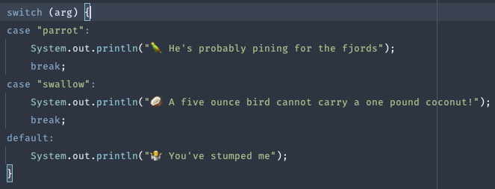
Java 7
Project Coin
Strings in switch statement

Slide 11
Java 7
Project Coin
Automatic resource management (try-with-resources)
Resource allocation as part of try
Automatically closed right before any catch or finally
Anything that implements java.lang.AutoClosable

Slide 12
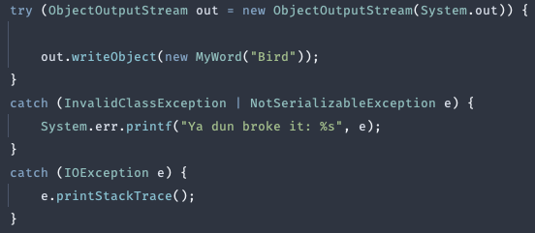
Java 7
Project Coin
Automatic resource management (try-with-resources)

Slide 13
Java 7
Project Coin
Catch multiple exception types (multi-catch)
Catch exceptions of multiple types in the same block
Exception types do not have to be “compatible”
Other rules for catching exceptions still apply (e.g. catch specific before generic)

Slide 14

Java 7
Project Coin
Catch multiple exception types (multi-catch)

Slide 15
Java 7
Project Coin
Generic type inference (diamond operator)
Type of generics on RHS inferred from types on LHS
Automatically closed right before any catch or finally
Anything that implements java.lang.AutoClosable

Slide 16
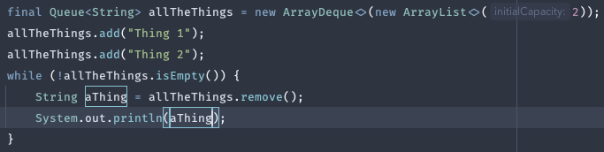
Java 7
Project Coin
Generic type inference (diamond operator)

Slide 17
Java 7
Project Coin
Numeric literal improvements
Declare binary integer literals
Use underscores in numeric literals

Slide 18

Java 7
Project Coin
Numeric literal improvements

Slide 19
Java 8

Slide 20
Java 8

Slide 21
Java 8
The Java 8 release marks Java’s first foray into functional programming

